Slide 1
IT Information for Graduate Students

Slide 2
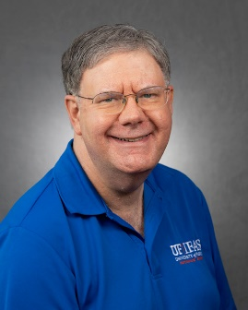
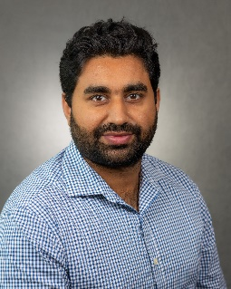
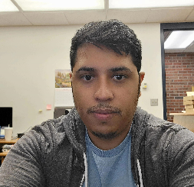
IT Department Personnel
  Dennis Brown (1255 Fifield, dennisb@ufl.edu, M-F, 8am until 5pm,
  Other times via e-mail or text), my cellphone number is 352-317-1701. Please give me your cellphone number or text me before calling
  Umar Javed (1255 Fifield, m.javed@ufl.edu, M-F, 8am until 5pm)
  Abdi Pimienta (1255 Fifield, apimienta@ufl.edu, M-F, 8am until 5pm)

Slide 3
IT Department can help in these areas
  To get IT help send e-mail to if-hos-it@ifas.ufl.edu.
  Access to Fifield wireless and wired network
  It is recommended for offsite students to be in contact by phone/text/e-mail in case there is an issue with a class that needs immediate assistance.
  Installing Departmental license software (Acrobat, SAS, VPN)
  Setting up shared printers and folders
  Setting up folders for backing up important files (Teams, OneDrive, DropBox)
  Security issues and viruses
  Local computer Admin policy
  Assist in locating local vendors to help with tasks outside of our job responsibilities.

Slide 4
Software Available to Students
Microsoft Office 365 ProPlus: Free Downloads
  https://it.ufl.edu/services/89
Other Software (SAS, JMP, Virus protection, etc.)
  https://software.ufl.edu (login with UF credentials)
UF Apps
  http://info.apps.ufl.edu/
Search for UF software
  http://www.ufl.edu

Slide 5
Equipment can be borrowed
  We have laptops, projectors, wireless remotes webcam and headset.
  Faculty are financially responsible for equipment damages.
  Please let us know if you have trouble with the equipment so that it can be fixed.

Slide 6
Available Resources
  Resources tab on Hortsci website. https://hos.ifas.ufl.edu/resources/
  Wireless is available throughout the building and many wired ports are available. Students provide their own network cable for most wired ports for laptops.
  Phones in student rooms.
  Student rooms benefit from being on the departmental network.
  Student Government provided printer available in the Hortsci mailroom, 1207 Fifield can be used to print anything as needed.
  Color copier/scanner and color printer in 1207 Fifield or lobby can only be used for research and grants, not thesis or class work.
  Color Copier/Scanner in 1207 will scan to e-mail.
  Video conferencing (Zoom/Teams) – please make meeting reservations as early as possible. Curtis and I set up Zoom for student Qualifying/Candidacy/Exit Seminars.

Slide 7
Personal laptops
  At one time I checked all laptops. Now the wireless setup routine does the security checks. We’re still glad to help.
  Make sure it works with UF wireless. The one to use is the eduroam wireless network. The one named “ufguest” is very limited and shouldn’t be used by UF students.

Slide 8
Classroom/Conference room usage
  Reserve rooms for meetings with me, especially video conference and a/v meetings.
  Please make sure rooms are locked and in good condition if you are the last one out.
  Make sure classroom projectors and microphones are turned off.
  Do not open and close the conference room folding walls. Only those with the wall cranks and training are permitted to open and close the walls.
  If you need video conference equipment, contact me to verify equipment availability and to discuss which room will be suitable for your meeting.

Slide 9

Miscellaneous
Windows 10 will not be supported by Microsoft or UF after October 14th, 2025. Contact us if you need your computer updated.
UF Helpdesk can help with most problems if IT staff is not available. 392-HELP (4357) helpdesk@ufl.edu, http://helpdesk.ufl.edu
No one from UF will contact you by phone or e-mail asking for your login credentials (user name and password). Don’t respond to e-mail requesting your credentials for any reason. Guard your credentials and change them if you suspect they have been compromised.
Use the Phish Alert Report button in Outlook to report suspicious e-mail.

Slide 10
Questions?

