Slide 1
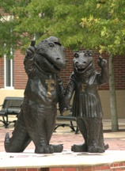
Welcome!
Introductions
Welcome from our Graduate Coordinator-Dr. Eduardo Vallejos
Welcome from our Chair –Dr. Christopher Gunter
Computer Information-Dennis Brown
Graduate Assistants United
The Plant Science Council
Important information-Curtis Smyder

Slide 2
Important Info., Registration and Forms
Curtis Smyder
Academic Advisor II

Slide 3
Introduction
Welcome!
UF ID Card
Parking
Student Information
Gatorlink
Registration/Courses
Forms
General Information
Health Insurance
Assistantships/Waivers
Questions and Answers

Slide 4
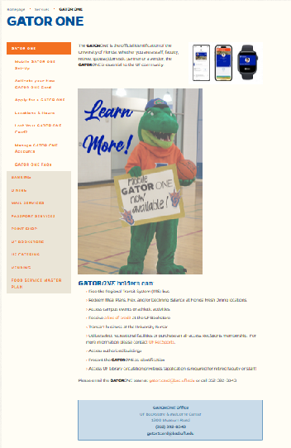
UF ID Card
Important!
  Sporting events
  Gym
  Bus services
Gator 1 Card - Business Services Business Services (ufl.edu)

Slide 5
Parking
You will need a parking permit
Parking on campus
  http://www.parking.ufl.edu/
  Parking Map: https://taps.ufl.edu/parking-info/parking-map/
  Bus services
  http://www.go-rts.com/
  Link to real-time bus locator:https://riderts.app/map
  An app for your smart phone is also available: https://taps.ufl.edu/alternative-transportation/rts/

Slide 6
SNAP – The Student Nighttime Auxiliary Patrol
SNAP – The Student Nighttime Auxiliary Patrol. SNAP is a free nightly campus safety and transportation service for currently enrolled students. The service is offered 7 seven nights a week 6:30pm – 3:00am in The fall and spring terms and 8:30pm – 3:00am in the summer terms. See SNAP » TAPS (ufl.edu). Additionally, there is a SNAP stop in front of Fifeld Hall. See this link for a map of the stops: SNAP Stops (ufl.edu).

Slide 7
Gatorlink
An GatorLink email account is required and important to receive UF and department messages
Make sure to send me your GatorLink email address

Slide 8
Student Information
On-stop source for student information: UF Student Self Service: https://one.uf.edu/
UF Student Self Services contains deadlines, course schedules, financial aid, etc.
You can search for classes via https://one.uf.edu/
There is a direct link to the Schedule of Courses as well: https://one.uf.edu/soc/.

Slide 9
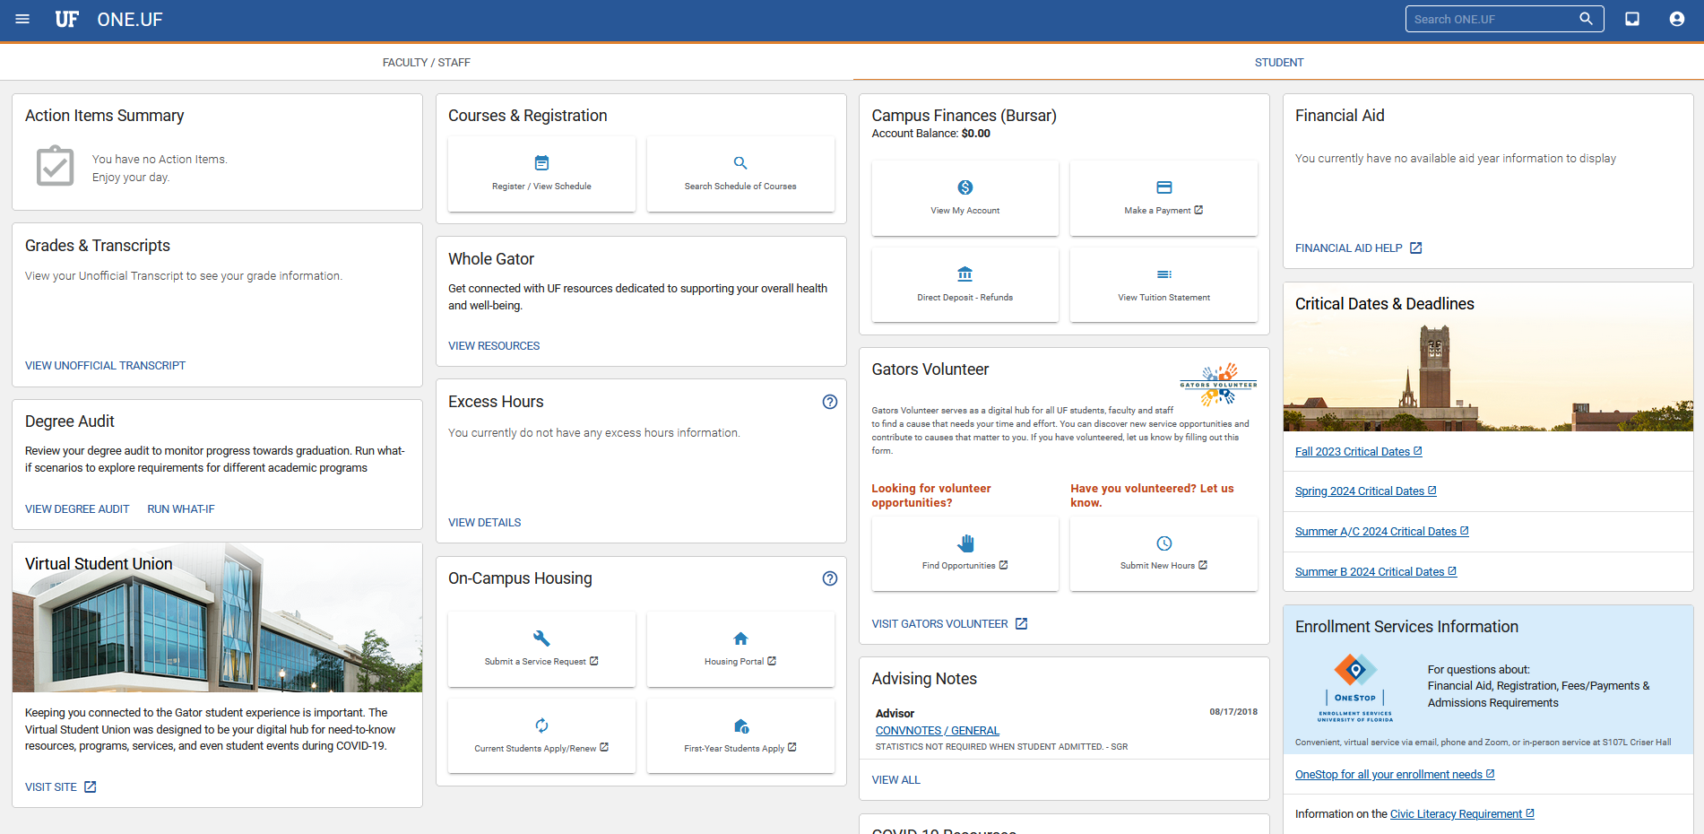
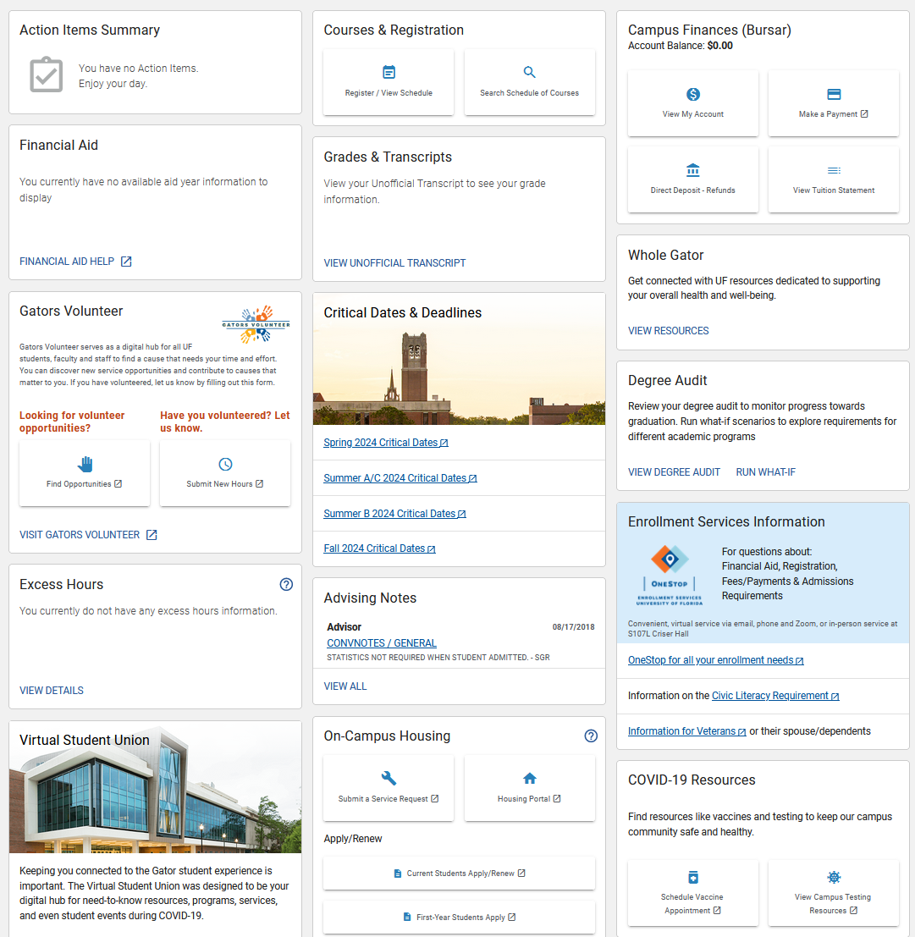

Slide 10
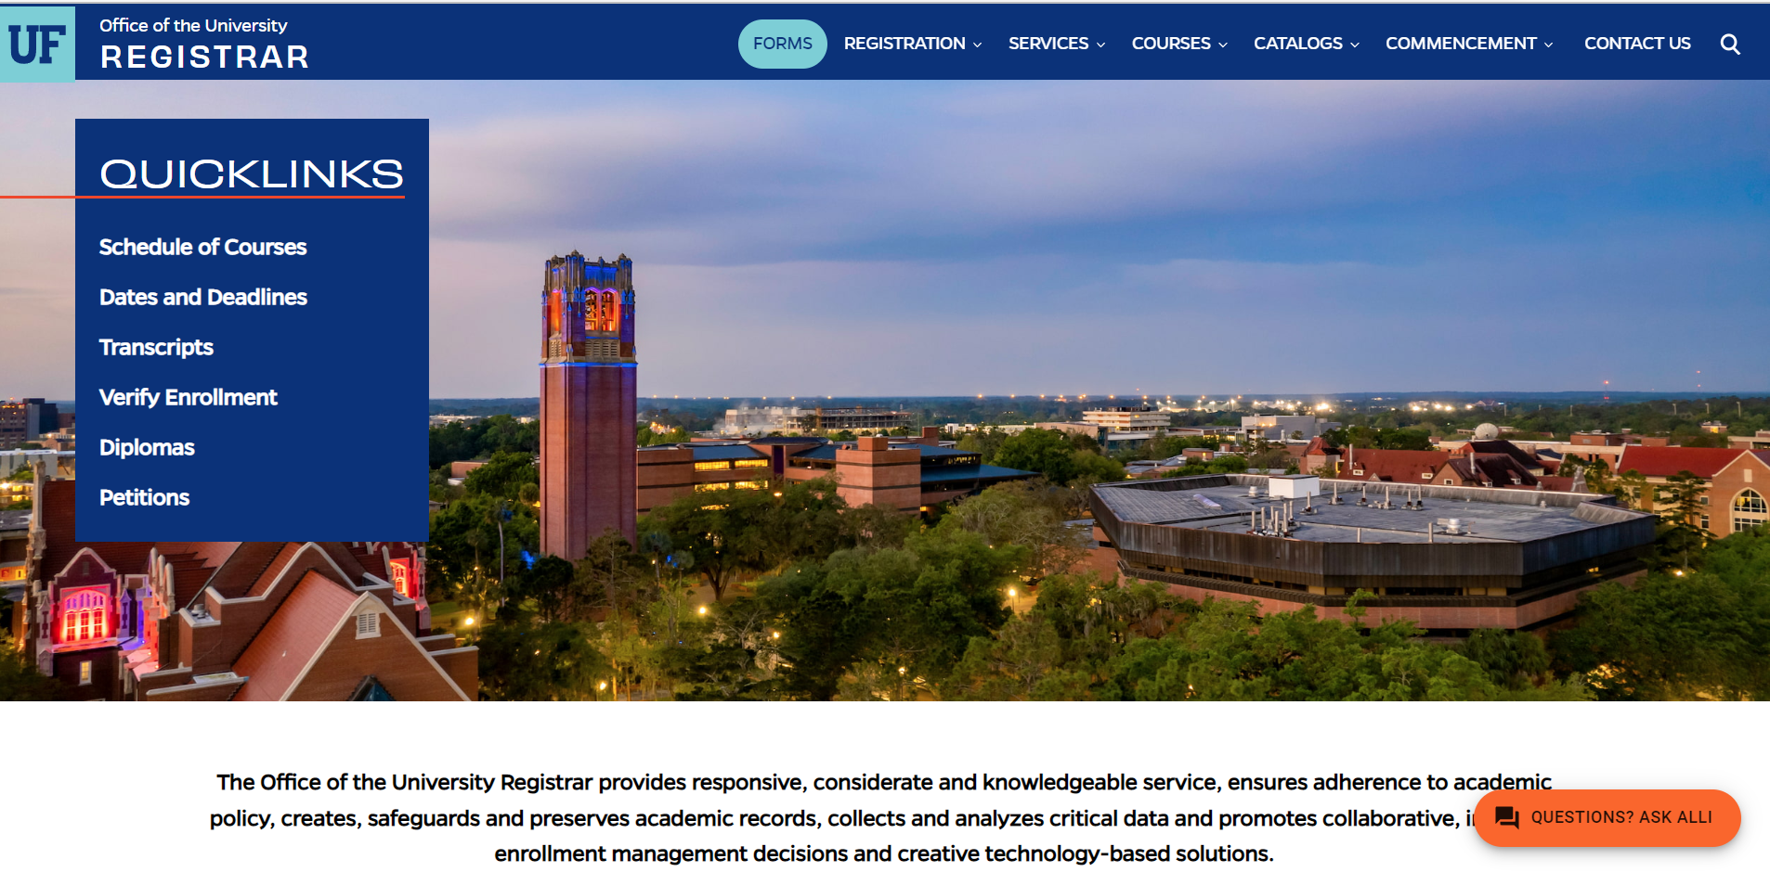

Slide 11
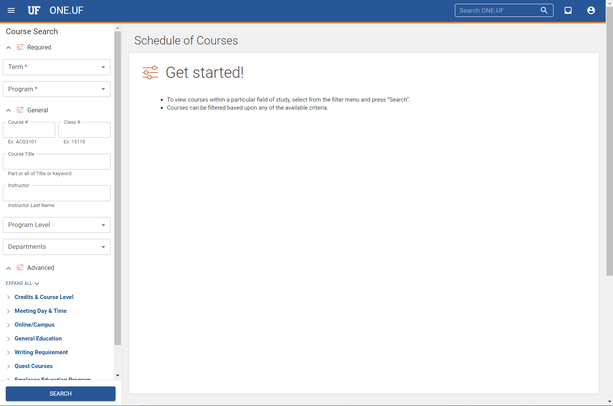

Slide 12
Registration
How it works
  Course Numbers
  Section Numbers
What I do
  Departmentally controlled courses
  i.e. research hours, special topics, independent study

Slide 13
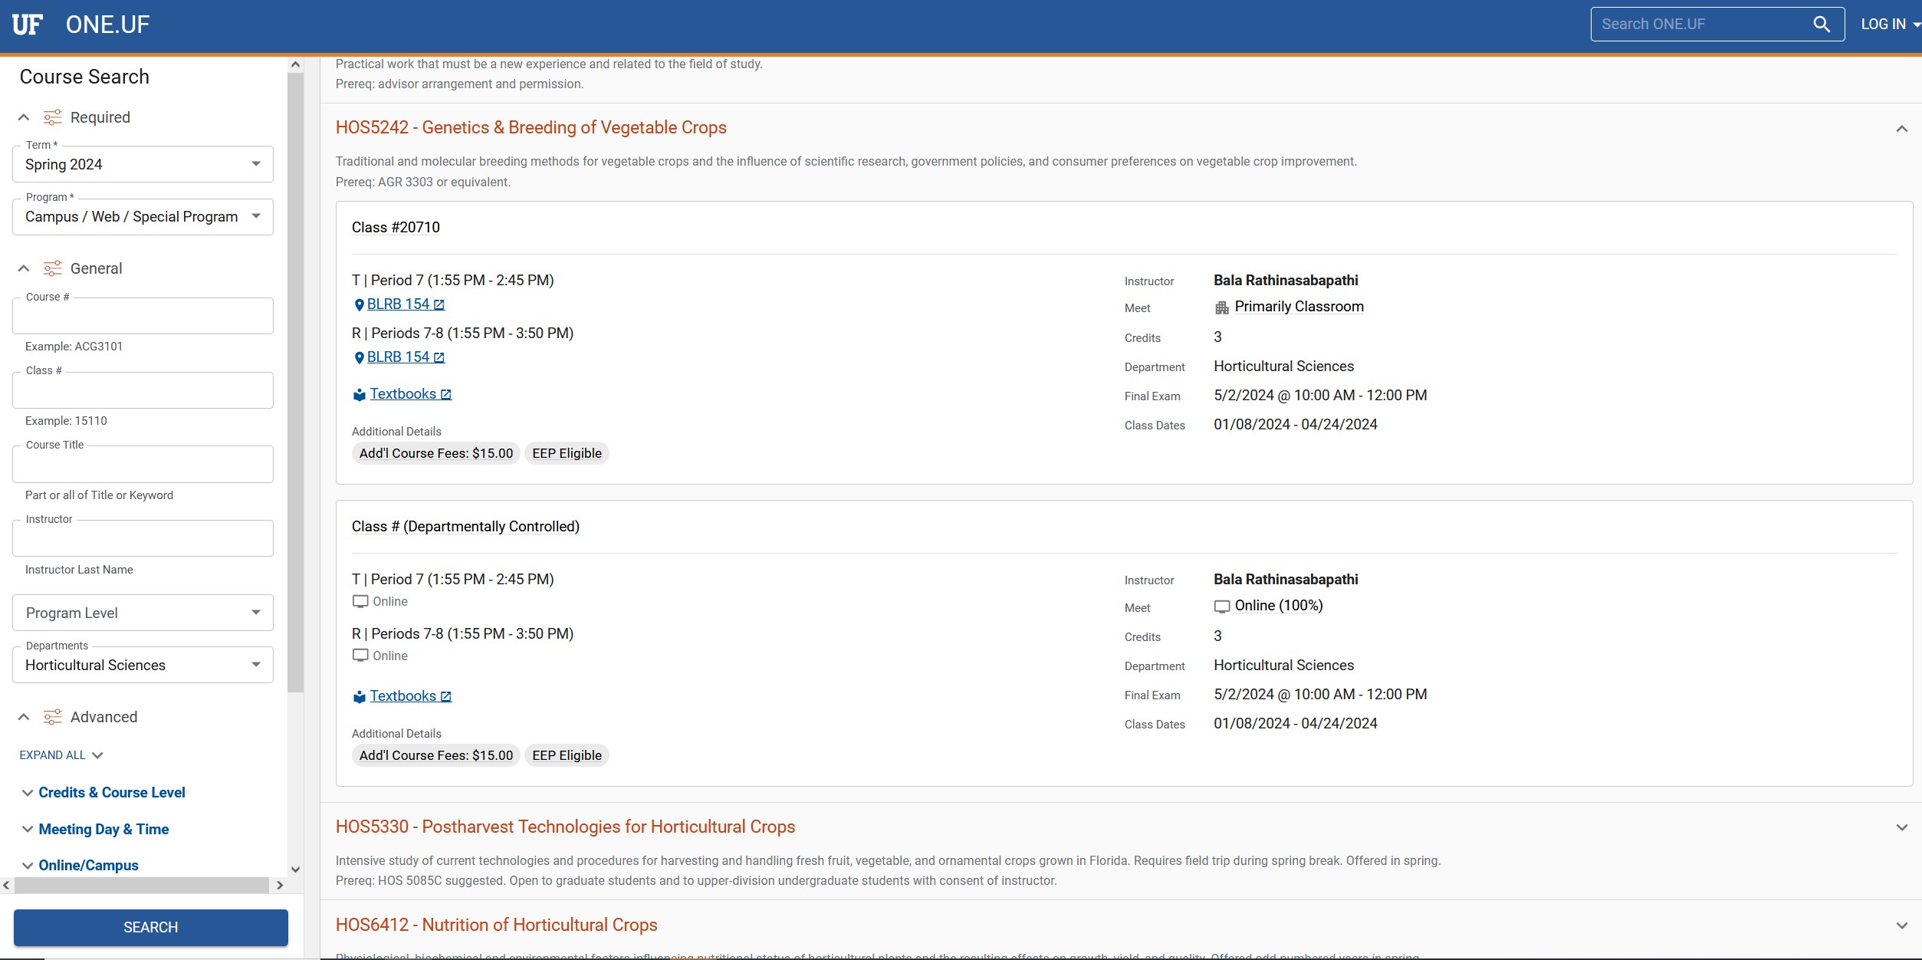
Course Title
Class number
Note section # is Dept. Controlled
Course Number

Slide 14
Registration, cont’d
Credit requirements
  Assistantship:
    9 credits Fall and Spring
    6 credits Summer
Course selection
  Advisor
  Committee
  Graduate Coordinator

Slide 15
Required Courses
12 credit hours of formal course work required in your major
  HOS and courses listed in the graduate catalog under Horticulture
Required Courses
  HOS 6934 - Professional Seminar Preparation
  HOS 6932 – Proposal Preparation
  HOS 6931 - Horticultural Science Seminar – Note that HOS6934 is a prerequisite to HOS6931
  HOS 4304/6932 - Horticultural Physiology
  STA 6093-Introduction to Applied Statistics

Slide 16
Forms
Supervisory Committee
Program of Study
Admission to Candidacy (PhD)
Final Exam Form
IDP Individual Development Plan

Slide 17
Forms-Supervisory Committee
What is it?
  Committee is formed to serve as a guide for your research and program of study
What if I change my mind?
  Changes can be made to your committee up until the semester in which you graduate

Slide 18
Forms-Supervisory Committee cont.
Ph.D.: Minimum 4 members total, 2 members must be within the HOS Graduate Faculty and 1 member must be outside the HOS Graduate Faculty, one member must be from the minor department, if there is a minor declared
Masters: Minimum 2 members total, 1 member must be within the HOS Graduate Faculty and one member must be from the minor department, if there is a minor declared
Minors require 12-24 credits of courses for Ph.D. students and at least 6 credits for Masters students at the 5000 level or higher

Slide 19
Forms-Supervisory Committee cont.
How do I form my committee
  Meet with your advisor first, before contacting potential committee members
  Identify professors with your same research interests
  Get to know the faculty members
Procedures
  Send me an email with the names of the members of the committee

Slide 20
Program of Study Form
What is it?
  Course work for the length of your study
How is it done?
  Email me and I’ll send you the form. Set committee meeting to discuss your courses
  After your program of study has been decided and the form filled out, turn the form to me with all signatures
What if I change my mind?
  Changes are easily made with a letter from your advisor

Slide 21
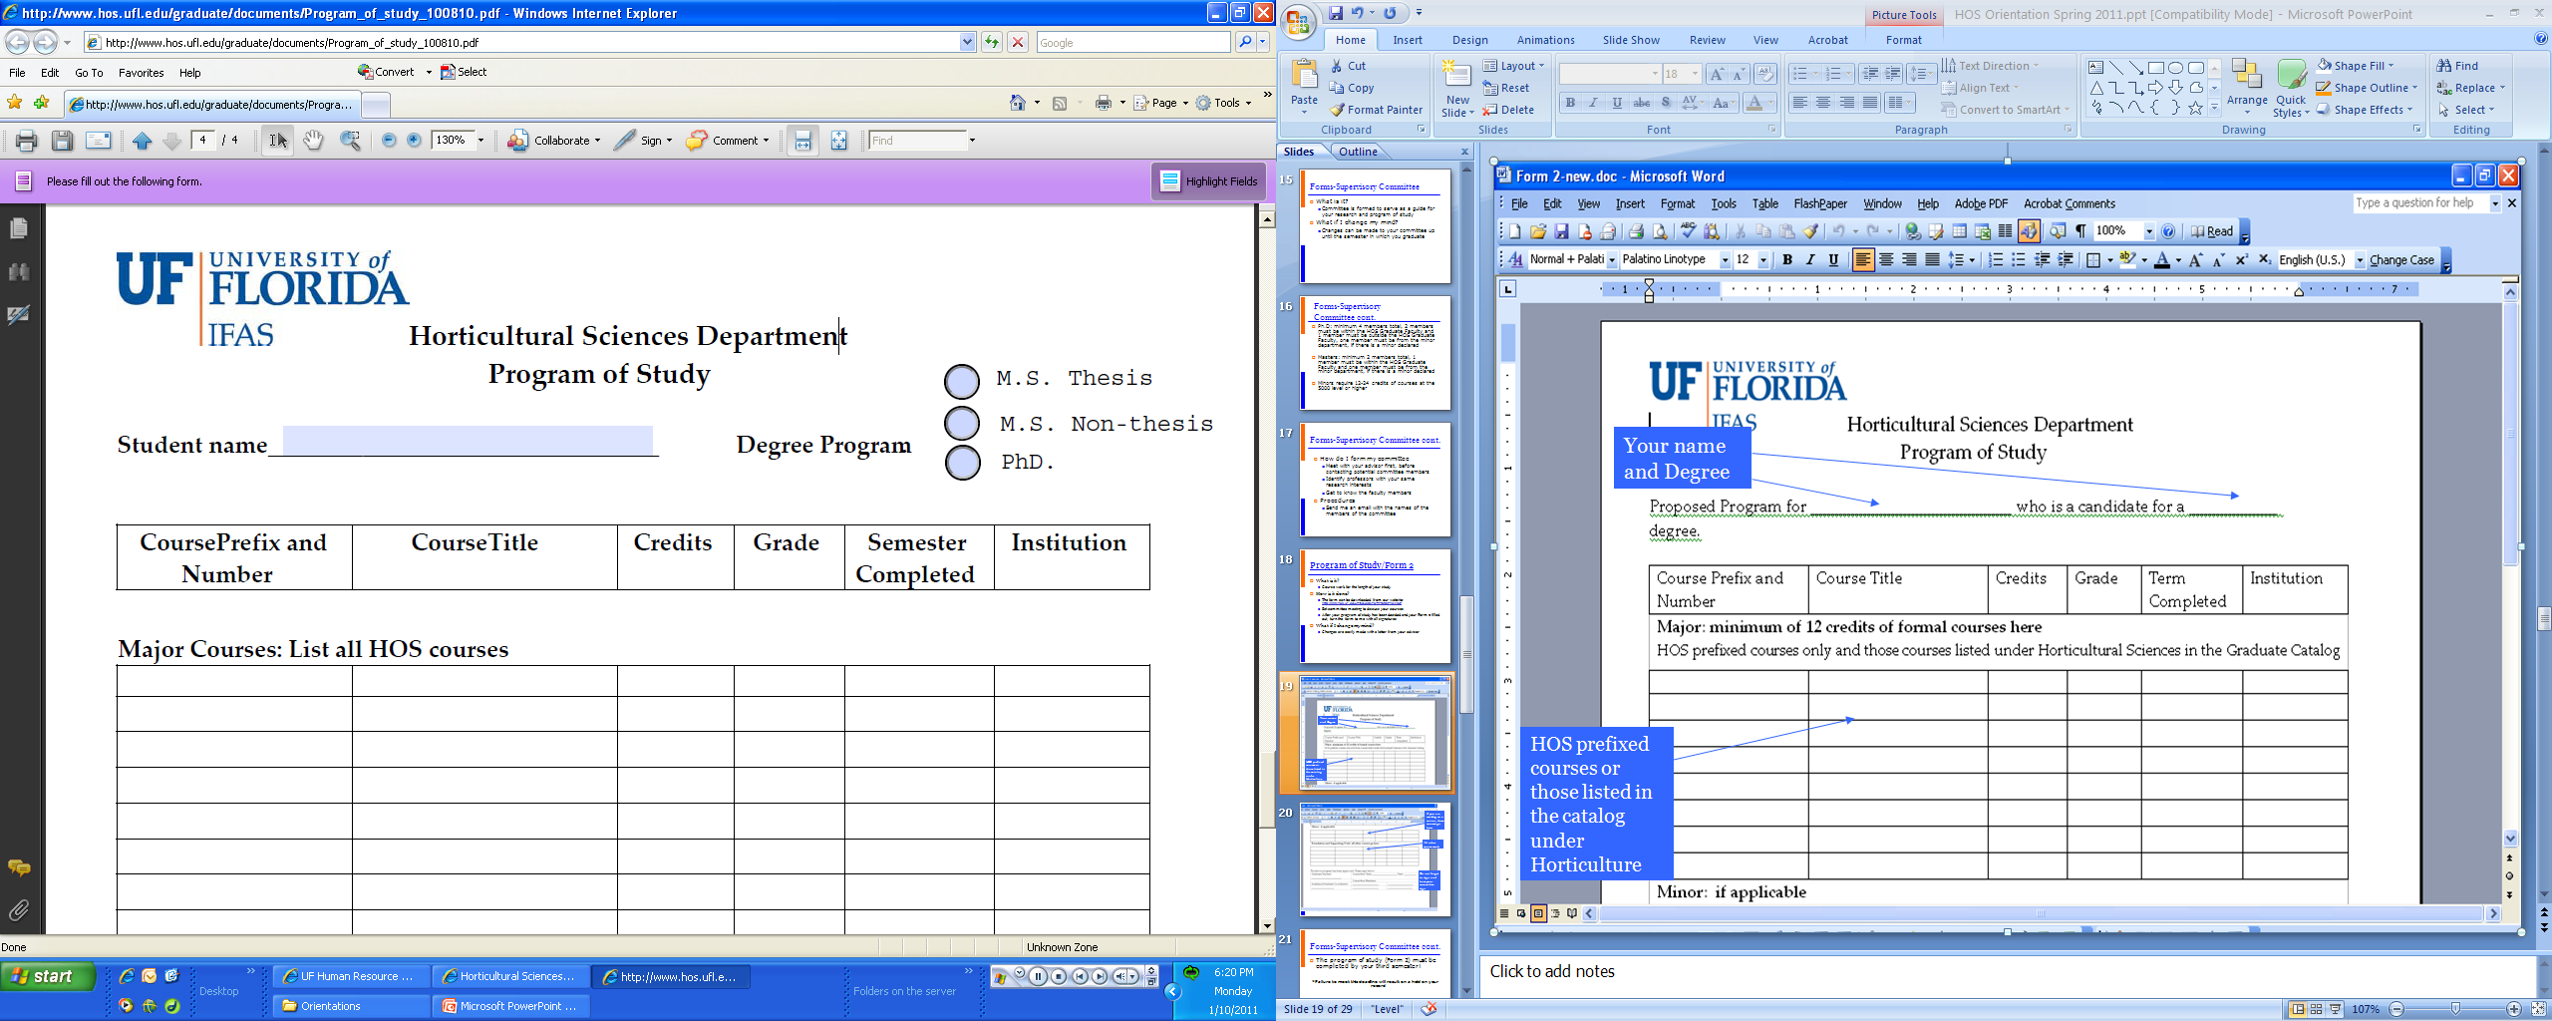
Your name and Degree
HOS prefixed courses or those listed in the catalog under Horticulture

Slide 22
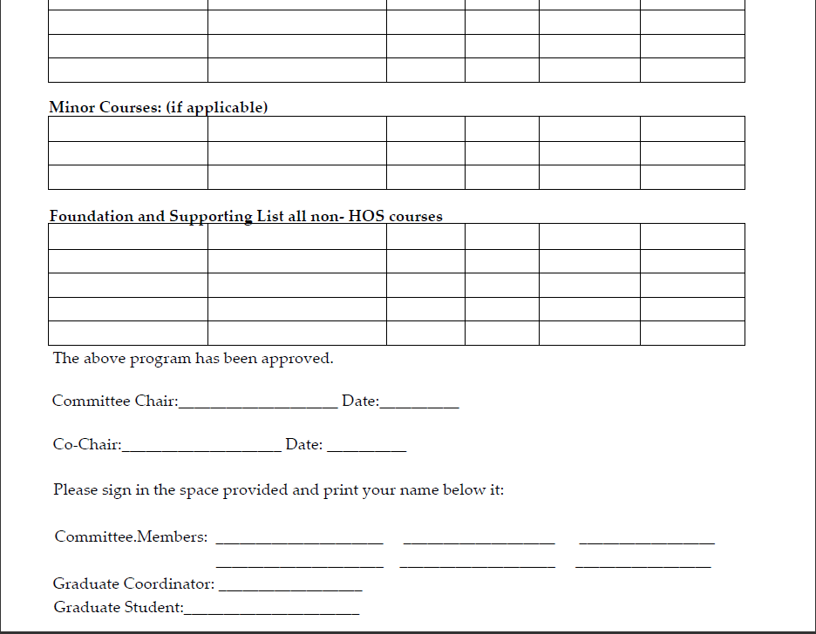
If you are working on a minor, those courses go here.
All other course work
Do not forget to sign and have your committee sign

Slide 23
Forms-Supervisory Committee cont.
The program of study must be completed by your second semester!
*Failure to meet this deadline will result on a hold on your record

Slide 24
Forms-other
Final Exam Forms
  Needed for final exam/defense
Procedures:
  Email me or stop by my office and I will send the forms to you or print the form out for you

Slide 25
Forms-Individual Development Plan
All Ph.D. Students are required to create an Individual Development Plan.
The document will be updated by the student each year.
The IDP is intended to be a working document, to guide new and continuing Ph.D. students in identifying, pursuing, and meeting their professional and personal goals.
Additional information on IDP: https://gradadvance.graduateschool.ufl.edu/planning-resources/idp/

Slide 26
Forms-Individual Development Plan
Link to IDP form for first year: https://gradadvance.graduateschool.ufl.edu/media/gradadvancegraduateschoolufledu/pdf-files/Year-1-IDP-Template.docx
Link to the IDP form for years 2-4: https://gradadvance.graduateschool.ufl.edu/media/gradadvancegraduateschoolufledu/pdf-files/Years-2-4--IDP-Template.docx

Slide 27
Adacemic Milestones
Academic Milestones – Please review the Horticultural Sciences Department Procedures and Regulations and keep track of the Academic Milestones for the degree you are pursuing.
https://hos.ifas.ufl.edu/media/hosifasufledu/documents/pdf/HOS-Graduate-Procedures-and-Regulations.pdf
  Failure to meet these deadlines will result in a registration hold being placed on your record!

Slide 28
Deadlines- UF
  Where do I find them? Bookmark these links.
https://catalog.ufl.edu/UGRD/dates-deadlines/2023-2024/#spring24text
https://gradcatalog.ufl.edu/graduate/calendar/
These are YOUR responsibilities
Current Deadlines for the Spring 2024 Semester:
Fees for those on assistantship or fellowship are due March 15, 2024 by 3:30pm.

Slide 29
General Information
Desk Assignments
  Please contact me if you need a desk assigned and I’ll assign you one as soon as possible.
  Please review desk policy
  Keys for graduate student offices and labs can be obtained from the Chair’s office.
Checks are automatically deposited into your bank account via direct deposit.

Slide 30
Tuition Waivers
Are currently being entered. Those students on assistantship or fellowship have an automatic fee deferment.
The spring deferment for students on an assistantship or fellowship is March 15, 2024. See this link for where this is posted: Critical Dates – Finance & Accounting (ufl.edu)

Slide 31
Tuition Waivers
If you want to pay early contact University Financial Services or visit this http://www.fa.ufl.edu/bursar/current-students/payments/
If you have any questions about your waiver, please come see me.

Slide 32
Questions/Assistance
Advisor
Curtis Smyder, Academic Support Services Coordinator
Dr. Vallejos, Graduate Coordinator

Slide 33
Any Questions?

